Slide 1


Slide 2
About today…
Objects
Methods
‘this’ keyword

Slide 4
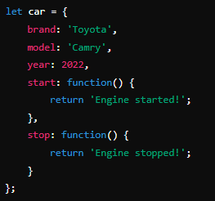
Intro to Object Methods
Definition
Object methods are functions defined within an object

Slide 5
Calling Object Methods
Procedure
Use dot notation to call object methods
Output
Engine started!
Output
Engine stopped!

Slide 6
this

Slide 7
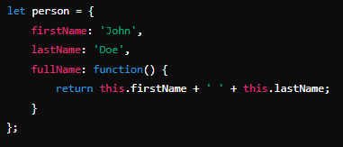
Creating Objects
Definition
This refers to the current object or context in which it is used
Example

Slide 8


Slide 9

How to correctly defines an object method in JavaScript?
How do you call an object method named “printInfo” within the object “person”?
What does the this keyword refer to in JavaScript object methods?

Slide 10

Task 1
Create an object named student with properties name and grade. Add a method displayDetails that logs the student's name and grade.
Task 2
Create an object book with properties title and author. Add a method ‘printInfo’ that logs the book's title and author using ‘this’.

